Slide 1
DATA ANALYSIS ON ORGANICS DATASET USING MACHINE LEARNING ALGORITHMS
Kavya Naveen Kumar
C00223350
Institute of Technology Carlow

Slide 2
Introduction
The primary purpose of this study is to implement the detailed analysis of the organics dataset which helps the supermarket to understand the demand for its recently launched line of organic products.
The collected data set for the analysis is about a scenario wherein a supermarket is going to begin a new line of organic products, and the management of supermarket would like to understand, what group of people are most likely to buy these recently launched organic products to improve their sales.

Slide 3
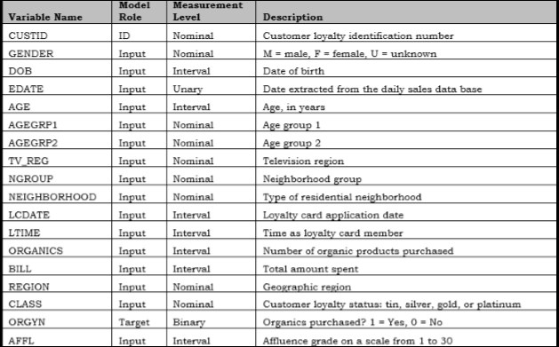
Data Understanding

Slide 4
Research Questions
1. Can we Predict Customers' Behavior?
2. How do the purchase orders differ by gender?
3. Does age play a part in purchasing organic products?

Slide 5
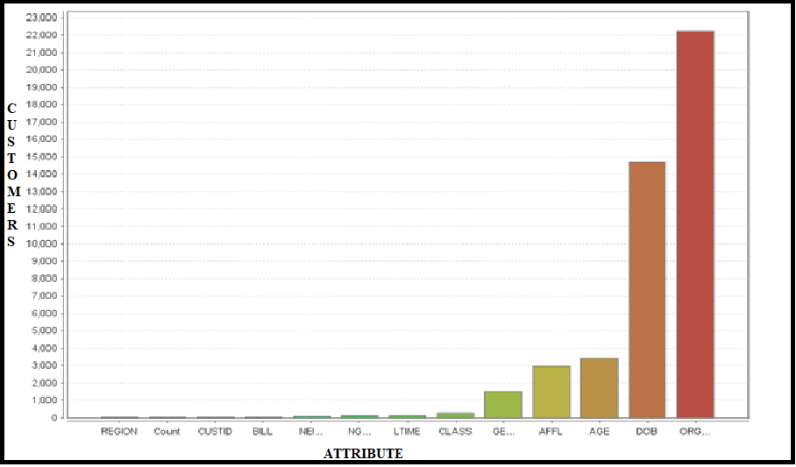
Chi-square test to understand which variable is most significant.

Slide 6
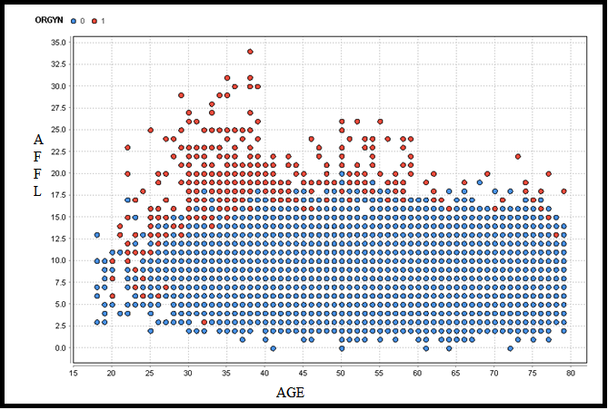
Exploratory data analysis

Slide 7
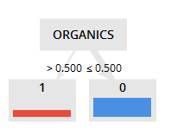
Data preparation:
The data set totally has 22,223 records and 18 variables.
Variables those are removed are :AGEGRP1, AGEGRP2, LCDATE, EDATE, NEIGHBORHOOD, BILL, DOB, and ORGANICS.
The ORGANICS variable explained a highly significant relationship with the target variable, yet when used in different models, resulted in several issues. For instance:
In a decision tree, the tree had only one level of depth with misclassification rate equal to zero as shown in figure below.

Slide 8
Modelling
Decision Tree.
Naive Bayes classifier
Deep learning
Logistic regression
Target Variable : ORGYN which has Yes / No categories. The data is distributed in 1:3 ratio.
Data split ratio: 80 % of the data is assigned to train the model and remaining 20% of the data is used for testing.
Tool used : Rapid miner data mining tool.

Slide 9
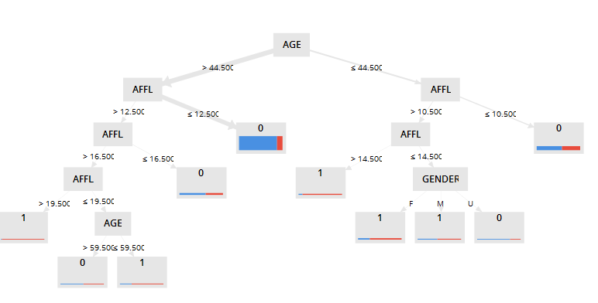

Modelling : Decision Tree

Slide 10
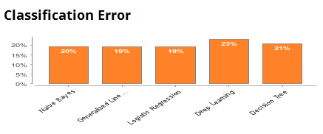
Evaluation

Slide 11
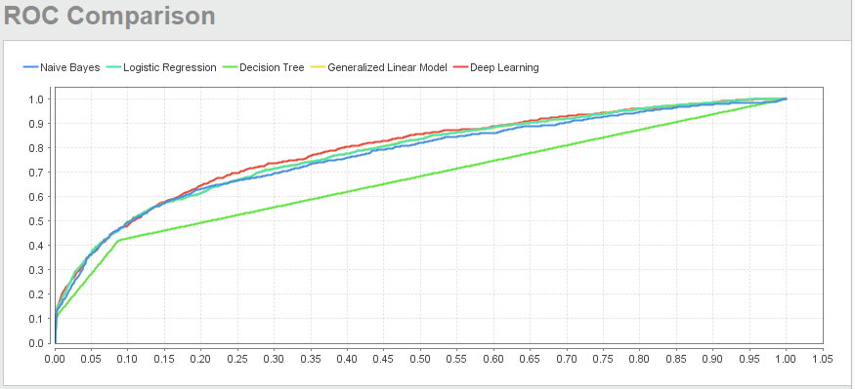
ROC Analysis

Slide 12
Conclusion
Logistic regression has the highest accuracy of 80.70 %. Hence, it is the best fit model.
From the explanatory data analysis it is evident that women buys more organic products than men.
We can also confirm that the people between the age group 30-40 tend to buy more organic products.

